Slide 1
The lecture 11
Exception handling

Slide 2
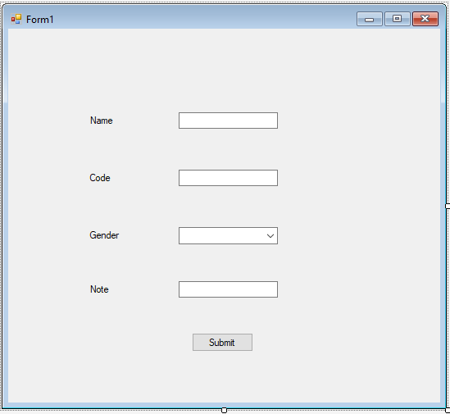
Adding textboxes

Slide 3
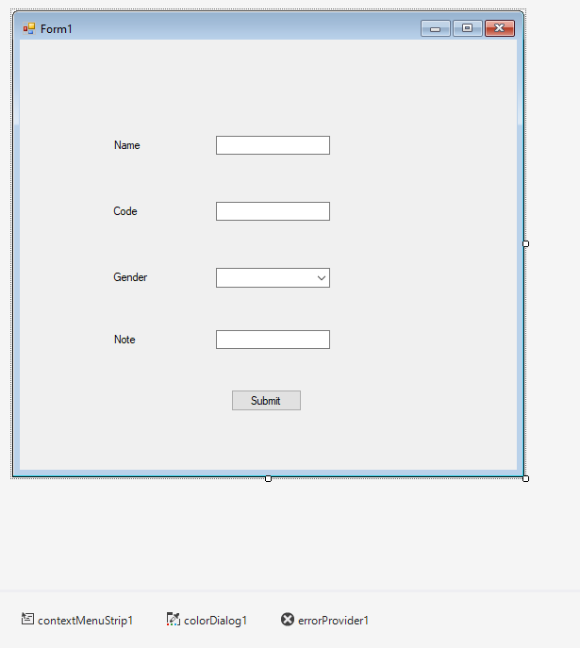
Adding context Menu and errorprovider

Slide 4
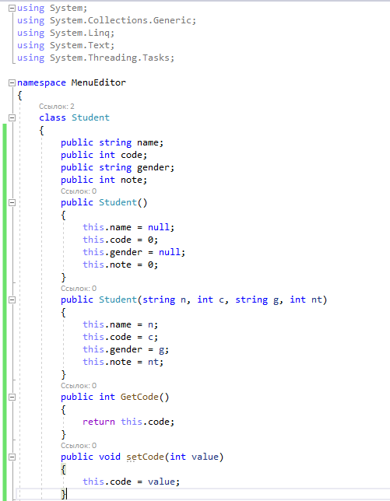
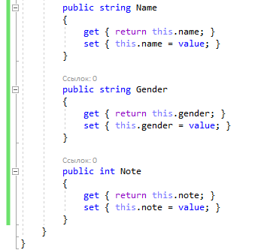
Creating a new class

Slide 5
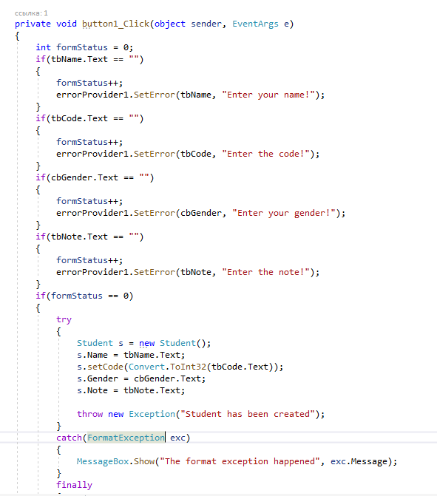
Adding error messages

Slide 6

Enter the form’s validation

Slide 7
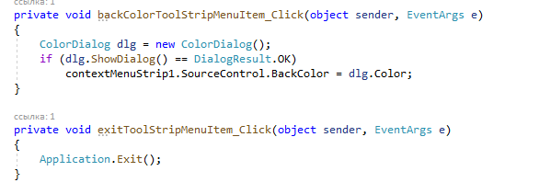
Adding context menu actions

Slide 8
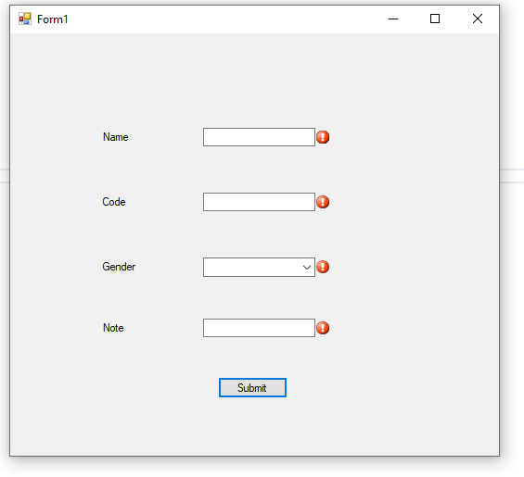
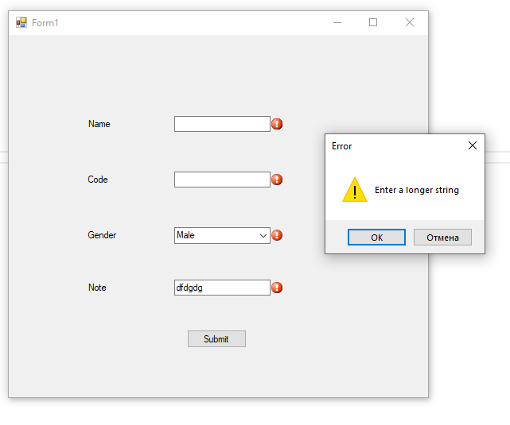
Form errors

